Slide 1
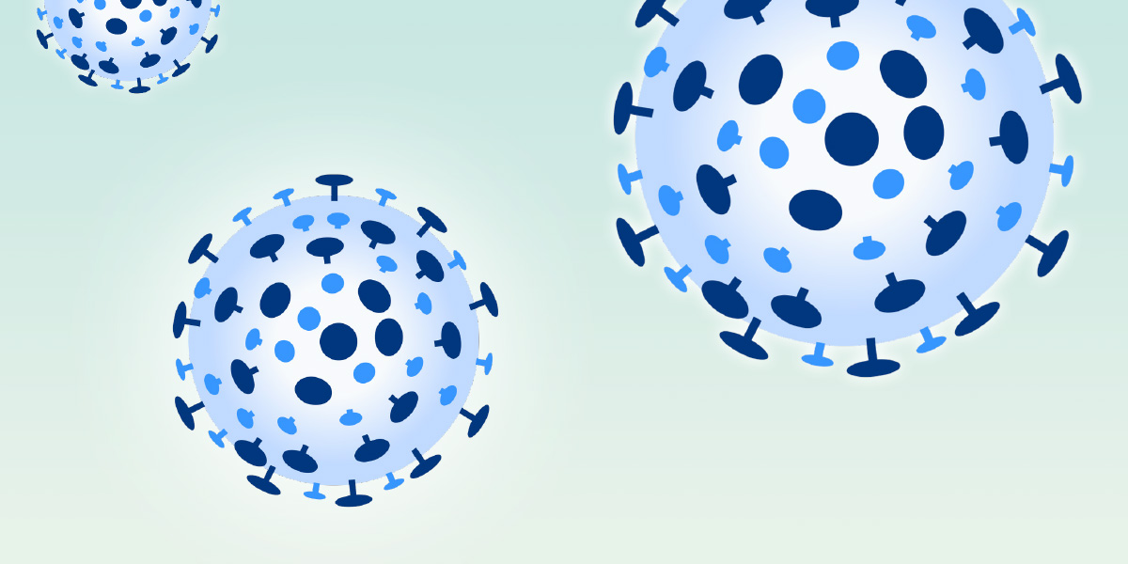

Covid-Predictor (CP) Healthy, Wealthy
Team Members :
Fayazuddin, Md – U01031155
Lalith, Banala – U01035260
Rushitha reddy, Sana – U01032105
Krithi reddy, Nareddy – U01034369
Manikanta, Rokkam - U01038113
Target Markets:
World Health Organization (WHO)
USA government (Health Department)

Slide 2
Problem Statement
Since being declared as a pandemic by the WHO in March 2020, Covid 19 virus has brought several tribulations to the world populace including deaths of loved ones, collapse of nation economies, collapse of businesses, loss of job opportunities, conflicts among family members, increased cost of livelihood among other effects.
The hospitality industry, international trade, educational and transport sector were among the most hit by the Covid outbreak.
Covid 19 virus has affected how we socialize with each other including religious related activities.
Physical and body contact interactions have significantly been reduced since the onset of coronavirus pandemic.
It has been harder to predict the prevalence occurrence of this virus at any particular time and place and the next location where its severity will be witnessed.
Scientifically, it has proven futile to predict which next place and time this virus will be most witnessed especially after being detected in a given place.

Slide 3
Methodology
We plan to develop a model that would be able to predict location(s) where the virus will have more or next prevalence in comparison to the immediate predecessor location(s).
Artificial Intelligence (AI) concept together with machine learning will aid in this.
Python SDK will be used in coding
Drones will be used to collect relevant virus information from patients and medical practitioners.
Drones are part of distributed computing technique and the information collected by them shall aid in the development of the AI.
We shall also rely on social media platforms to collect information from relevant individuals that would help populate further our predictability pattern.

Slide 4
Justification
This solution will protect the data of individuals involved in its development and will be free of any ethical considerations by relevant governmental agencies.
The output will be based on the input that’s fed into the application e.g., if we feed in patterns of virus across different locations and hotspots then it should learn and predict the location that is most suspicious to the virus.

Slide 5
Market Research
Currently, there are no available apps on covid 19 predictability pattern.
The available research findings and outputs have been based on contact tracing and the assumption that a place with so many contacts traced might witness higher prevalence than the rest.
However, there are other predict models in other sectors like weather, animal and crop production, etc.

Slide 6
Suitability
We plan to pitch this model to the WHO team, the USA national government (Health Department) since corona virus is still a global pandemic that requires collaboration of governments and not business entities.
This model will assist governments to have prior plans on how, where and when to mitigate and respond to corona virus related emergencies.

Slide 7
The Business Model
Pitching to the government and WHO.
We shall set a purchase price tag for our model after reviewing all the costs involved in its development and testing.

Slide 8
Team’s Contributions
Team Member | Areas of Expertise | Contributions Made
Lalith & Manikanta | AI, Machine Learning | Coding, social media monitoring
Fayazuddin | Database, Programming | Analyzing & classifying data collected, coding
Krithi reddy | Networks | Configurations of networks and network devices used
Rushitha reddy | Biomed Computing | Research on corona virus

Slide 9
Getting Started
Activity | Duration
Planning and system design | 2 months
Model Development | 2 months
Model technical validation | 1 month
User Testing | 1 month
Gaining Market Entry | 1 month
Scale up and recommendations | Infinite

Slide 10
Enabling Tools for Development & Communication
Python SDK
Facebook, Linked-in
GitHub
Google Doc

